Slide 1
Report for BFX – AT 100
Power Jack Discoloration Issue
Prepared By: QA: Rachel Ruan
Reviewed By: QA leader: Toney HB
Factory leader: David Yin
Date: Jul-26-2023

Slide 2
D1
Establish the Team
Team Leader
Team Member
  QA leader: Toney HB
  Operation leader: David Yin
PM: An Tran, Ben Zheng
QA: Rachel Ruan
SQE: Mr Ha, Antony
IE: Hai Ly
PD: Wen Yong
Notes:
MA5800-X7#display cable modem <MAC> detail

Slide 3
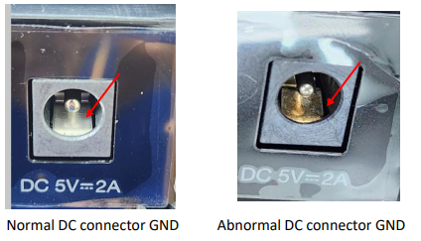
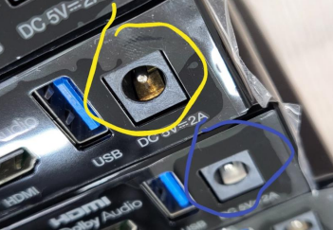
D2
Description the Problem
Issue Description (5W2H)
When | Jul-21-2023
Who | ALT Customer
Where | SK networks warehouse ALT Visual inspection Station
What | DC connector of BFX- AT100 Model was discoloration issue
Why | The GND metal of DC changed from silver to gold color
How | Inspection after cleaning Result PASS
How many | NG Defect : 12/26000 = 0.046%
OK
NG

Slide 4
D3
Containment Action
Check inventory and sorting
1. Fii implement hold and sorting 3550 PCBAs at PTH .
Owner: PD/ Wenyong, Done on Jul-21
2. Fii perform 100% sorting for T99X171.00 in stock.
Owner: PD/ Wenyong, Done on Jul-24
Model | Sorting Q’ty Requirement | Aready sorting Q’ty | Fail Q’ty | Fail Rate
T99X171T00 | 3550 | 3547 | 3 | 0.086%
T99X171.00 | 13440 | 13440 | 0 | 0.0%
Total | 16990 | 16987 | 3 | 0.018%
3. Fii hold and sorting 15k raw material at warehouse , No found same issue.
Owner: SQE/ Peter, Done on Jul-22
Notes:
5.26891E-07 4.96855E-07

Slide 5
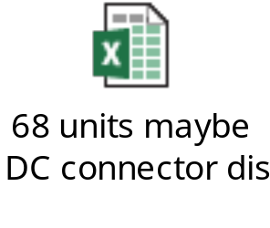
D3
Containment Action
Check SFIS data
Base on NG serial numbers provided by customer, Fii re-checked SFIS data and found out production time at PTH of these units focus in Jan-2023.
Therefore, Fii re-checked SFIS data of 26k - shipment lot in Jun-2023 and found total 68 units (include 12pcs was detected by customer side) also have production time at PTH before Jan-2023.
STT | MAC ID | SHIPPING SN | T Level SN | PTH Station Time
1 | BCF4D4F9A4F8 | 2149688001202301187972 | YXY2OQO | 2023-01-26 16:33:20
2 | BCF4D4F980B8 | 2149688001202301187973 | YXY2JRO | 2023-01-27 08:50:09
3 | BCF4D4F98263 | 2149688001202301187974 | YXS0MH0 | 2022-12-03 01:38:49
4 | BCF4D4F9750A | 2149688001202301187975 | YY21A2R | 2023-02-13 04:06:37
5 | BCF4D4F9ABA4 | 2149688001202301187977 | YY216UE | 2023-02-13 13:31:02
6 | BCF4D4F9A4FB | 2149688001202301187979 | YY21IG0 | 2023-02-17 05:38:22
7 | BCF4D4F9A316 | 2149688001202301187982 | YXY2JGD | 2023-01-28 01:34:56
8 | BCF4D4F9B920 | 2149688001202301187983 | YY21HW4 | 2023-02-17 02:59:40
9 | BCF4D4F98539 | 2149688001202301187984 | YY21GBL | 2023-02-14 04:57:29
10 | BCF4D4F9C75B | 2149688001202301187986 | YY21IEZ | 2023-02-17 15:41:05
11 | BCF4D4F9890D | 2149688001202301187987 | YY709RI | 2023-03-18 08:02:15
12 | BCF4D4F9A4F1 | 2149688001202301187988 | YY21D04 | 2023-02-13 22:47:30
Fii Re-check test data of 68pcs didn’t find any abnormal relate to connection of DC connector.
Summary: As SFIS data, these NG unit focus on PTH production time in Jun-2023, so maybe remaining 56pcs in total 68pcs also has same issue.
Notes:
5.26891E-07 4.96855E-07

Slide 6
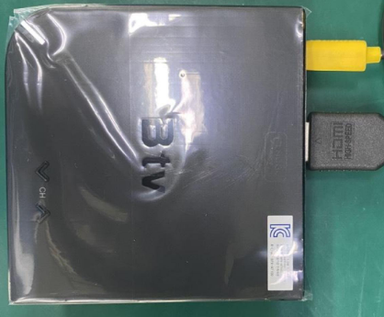

D3
Containment Action
Verify 5pcs (DC connector discoloration) flow chart
A
FT1
FT
RC
Assy
UK
A
Verify
RC1
RC2
Burning
OK
Plug & Un-plug
*10 times
Check bootup
OK Normal
Summary:
Contact resistance OK normal.
DC connector discoloration is VI issue, don’t defect function.
Notes:
MA5800-X7#display cable modem <MAC> detail

Slide 7



D3
Containment Action
1 . SQE sent NG sample ( DC connector discolor) to vendor for analysis.
Owner: SQE/Ha. Done: 2023/Jul/24.
Waiting FA report from vendor . Due date: 2023/Aug/15.
2 . Make quality notice to guide OP must to check DC connector discolor issue.:
Owner: PQE/Rachel. Done : 2023/Jul/21
3. Add OK and NG picture on SOP and re-train OP staffs have to check all connector abnormal ,
discoloration issue .
Owner : IE/Yona. Done : 2023/Jul/22.
Notes:
5.26891E-07 4.96855E-07

Slide 8
D4
Root Cause
Occurrence reason
Suspect material issue ( Waiting vendor confirm and provide FA report)
4. Escape reason
The defect is no effect on the product function, and on SOP/SIP no define check DC connector discoloration issue.
Notes:
5.26891E-07 4.96855E-07

